Slide 2
A DevOps Pipeline for Real Time Social/Web Mining

Slide 3
Abstract
There is a vast amount of data created everyday.
Most of the data is unstructured and difficult to analyze
This project aims to derive meaning from that crucial data.

Slide 4
Introduction
Social web mining is the process of representing, analyzing and extracting patterns from raw social media data.
Real-time web mining means that the response is delivered within a particular timing constraint or system should meet the confirmed deadline
The project collects information from tweets of specified hashtags and geolocation-based

Slide 5
How did we process these large amount of tweets?
For the enormous data processing that was needed in this project we used the Hadoop ecosystem
Sentiment Analysis was performed on the tweets. Classifying them into
Strongly Agree
Agree
Neutral
Disagree
Strongly Disagree

Slide 6
Motivation
Data is invaluable.
It is necessary that some insights are drawn from the vast amount of data created everyday.
This project aims to analyze the information in the form opinions that are either positive or negative, or somewhere in between these two.
The analysis will help better market our product and ensure it reaches the right audience.

Slide 7
Motivation
Data is invaluable.
It is necessary that some insights are drawn from the vast amount of data created everyday.
This project aims to analyze the information in the form opinions that are either positive or negative, or somewhere in between these two.
The analysis will help better market our product and ensure it reaches the right audience.

Slide 8
Problem Statement
There are two main problems with analysing social media content:
It is unstructured, the inherent design of social media makes it difficult to analyse.
The sheer amount of data.

Slide 9
Objective
This project aims to create a fully automated application that extracts information in real time from the social media
The sub objectives needed to be completed to accomplish the main objective are:
To create a web crawler using Twitter API and OAuth protocol.
Populate dataset with unstructured data in real time using HDFS
Create Hadoop clusters and use YARN to manage Big Data pipeline.
Perform Data Analytics by running machine learning algorithms on Pig, Impala etc.
Visualize data using Kibana, Matplotlib etc.

Slide 10
Literature Review
Semantic analysis is a very trending topic, a lot of work has been done in this sector in the past few years. Bo Pang and Lee pioneered this sector.
We also referred to the research paper “Large-Scale Machine Learning at Twitter”^{[1]} using machine learning tools integrated into Hadoop Clusters analysed by pig. They have used a knowledge-poor, data-driven approach.

Slide 11
Algorithm: Training Job
Input: The training reviews.
Output: Model.
1. define function MAPPER(key, value)
2. s = parse_sentiment(value)
3. for all w belongs to d do
4. emit(w, 1 : s)
5. end for loop
6. end Mapper()
7. define function REDUCER(key, values)
8. declare posSum = 0; negSum = 0;
9. for all value in values do
10. [s, count] = parse(value)
11. if (s == positive) then
12. posSum = posSum + count;
13. else 14: negSum = negSum + count;
15. end if 16: end for loop[
17. call emit(key, posSum, negSum)
18. end function

Slide 12
Algorithm: Combining Job
Input: The test reviews and the model.
Output: Intermediate results from input of job classification.
1. function MAPPER(key, value)
2. if value in model then
3. [word, possum, negsum] = parse(value)
4. emit(word, possum, negsum)
5. else
6. [docid, sentiment] = parse(value)
7. for all word in value do
8. emit(word,1,docid,sentiment)
9. end for loop
10. end if

Slide 13
Algorithm: Combining Job
11. end function
12. function REDUCER(key, values)
13. for all value in values do
14. if value in model then
15. outstr.append(value)
16. else
17. [count, docid] = parse(value)
18. docs[docid].add(count)
19. end if
20. end for loop
21. for all docid ∈ docs do
22. outstr.append(count,docid)
23. end for loop
24. emit(word, outstr)
25. end function

Slide 14
Algorithm: Classify Job
Input: The intermediate results.
Output: Classification results and accuracy.
1. function MAPPER(key, value)
2. for all item in value do
3. [docid, count, possum, negsum] = parse(value)
4. emit(docid, count, possum, negsum)
5. end for loop
6. end function
7. function REDUCER(key, values)
8. [docid, trueSentiment]=parse(key)
9. for all value in values do
10. calculate positive probability

Slide 15
Algorithm: Classify Job
11. calculate negative probability
12. end for
13. predict = (pos prob > neg prob) ? pos : neg
14. if predict = trueSentiment then
15. correct = true
16. correct count + +
17. else
18. correct = false
19. end if
20. emit(docid, predict, correct)
21. end function

Slide 16
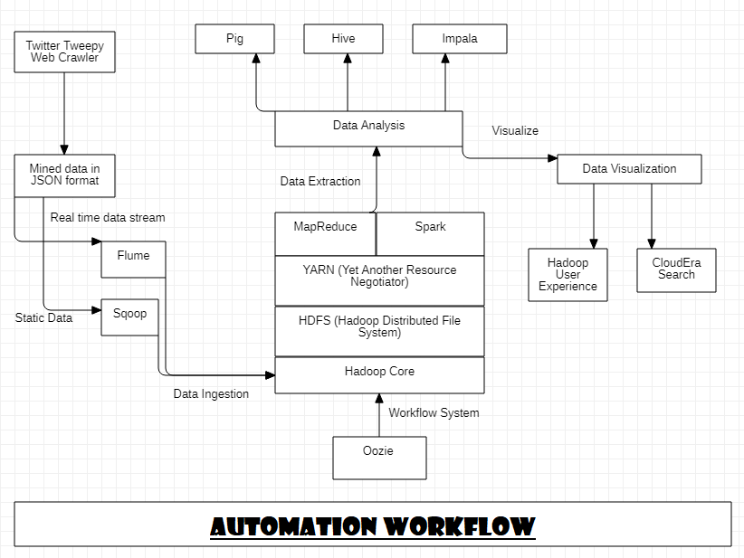
Proposed Method

Slide 17
Extraction of Real-Time Data
Extracting tweets using the twitter API.
B. Stemming and Lemmatization
Converting into root word too reduce space used.
C. Sentiment Directory
Forming a sentiment dictionary that is used to score each tweet.
D. Map-reduce
Processes every tweet and assigns the sentiment to each remaining words of tweet and then sums them up to find the final sentiment

Slide 18
MapReduce Process
MapReduce consists of two major tasks which itself consists of two minor tasks each.
1. Map Process
Split function
Map function
2. Reduce Process
Combine/Shuffling function
Reduce function

Slide 19
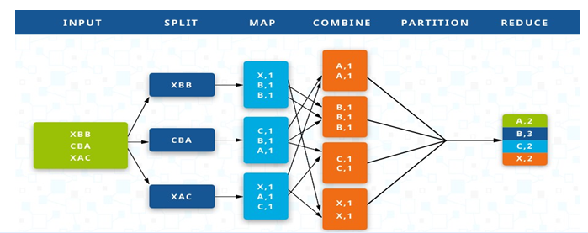
MapReduce Example

Slide 20
System Requirements:
Software:
Python 3.7 or above
JDK 11 or above
Hadoop Architecture
Supports Windows XP, Vista, 7, 8, 8.1 and 10
Hardware:
6 GB RAM or above
I5 5th Generation or above processors

Slide 21
SDLC Model: SCRUM Model
The entire project is divided into individual modules, based on their functionalities.
Which will be developed in isolation by the entire team, based on the priority of implementation.
Using the Version Control tool Git.
Efficiency Parameters
Velocity: Velocity is the speed by which our crawler mines data and stores it into our HDFS cluster.
Throughput: Throughput is how much data the project can analyze in unit time.
Accuracy: Accuracy will help us understand how many tweets were successfully based on the sentiments of each tweet.
Storage: We need to do all this in a realistic amount of space as the data we will be handling is huge.

Slide 22
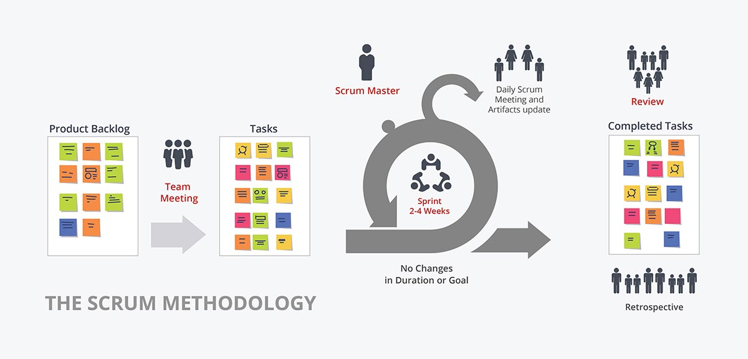
Scrum Model

Slide 23
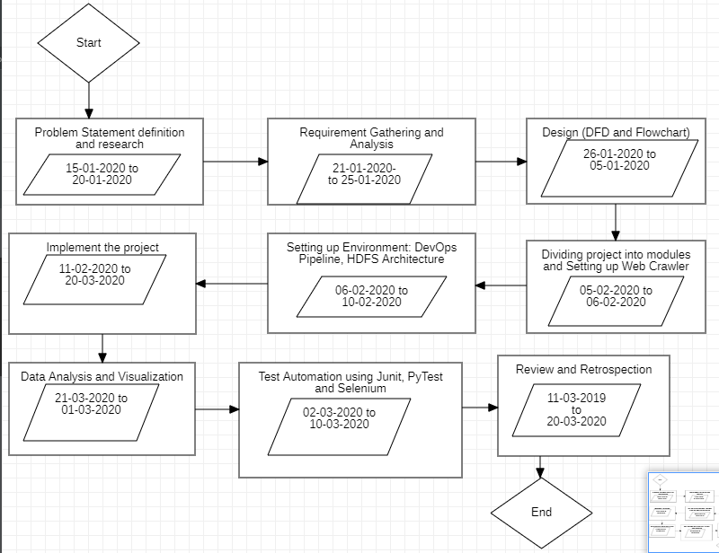
Plan of Work

Slide 24
Product Backlog
1] Setting up Apache Maven for Java project - User Interface and MapReduce functions
2] Setting up GitHub repository workflow
3] Setting up GitHub Actions for automation
4] Creating a web crawler in Python using Tweepy library to fetch data based on some parameter.
5] Create a User Interface
6] Create a HDFS cluster for MapReduce functionality and program Hadoop MapReduce in Java
7] Setup Hadoop Core and create Job Tracker and Task Trackers for the project
8] Implement MapReduce in HDFS using Java to count the frequency of significant words in Data dictionary, in Twitter string

Slide 25
Product Backlog
9] Configure Apache Maven with MapReduce codes and install Apache Hadoop Jar dependency
10] Automate the Big Data pipeline till MapReduce using GitHub Actions
11] WAP in Java to implement MapReduce from JSON file extracted from crawler to find the frequency of significant words - Textual Analysis
12] Data Classification - create a multi-class data dictionary for sentiment analysis - currently for words (in future, we might extend it for phrases and sentences for improved accuracy)
13] Data Visualization - Using the Python matplotlib library to implement visualization.

Slide 26
Project in Production
Twitter Crawler in Python
Hadoop Clusters in declarative yml files
Apache Maven project dependencies in XML
MapReduce programs in Java
Sentimental Analysis algorithms in Python
Data Visualization program in python
Integration and configuration code in Shell Scripting
View our project at: https://www.github.com/StormsinBrewing/Real_Time_Social_Media_Mining

Slide 27
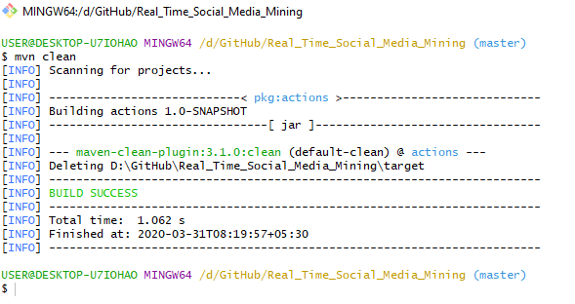
Maven Setup: Clean Goal

Slide 28
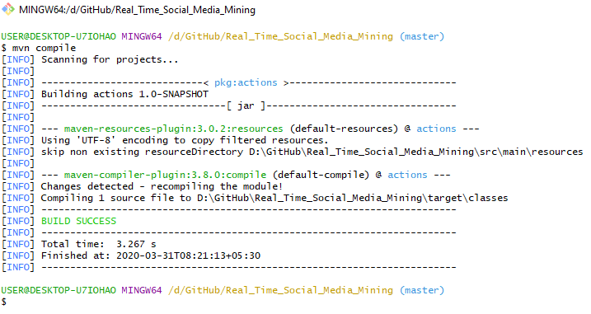
Maven Setup: Compile goal

Slide 29
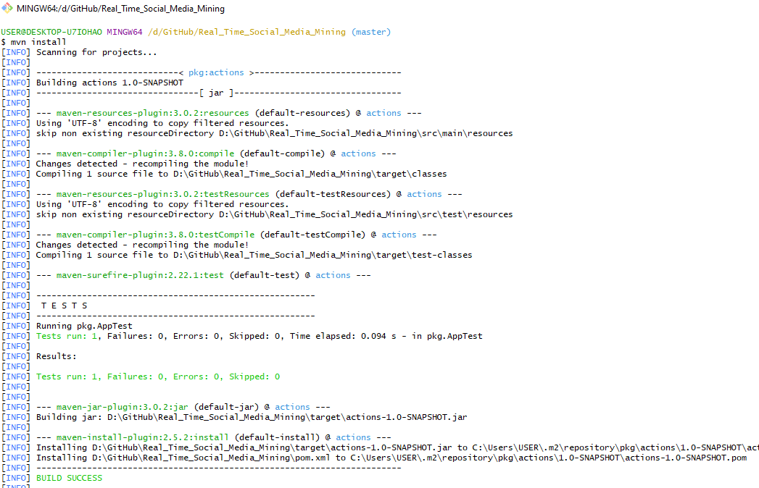
Maven Setup: Install Goal

Slide 30
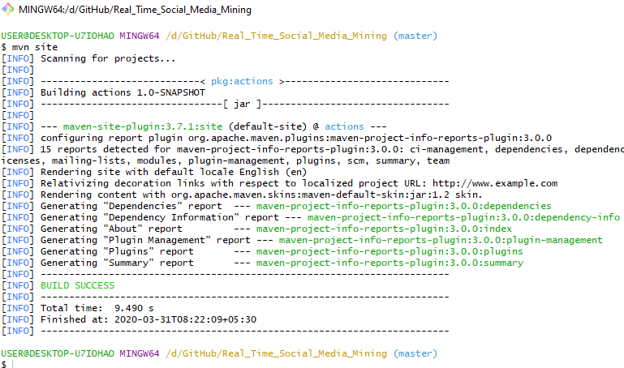
Maven Setup: Site Goal

Slide 31
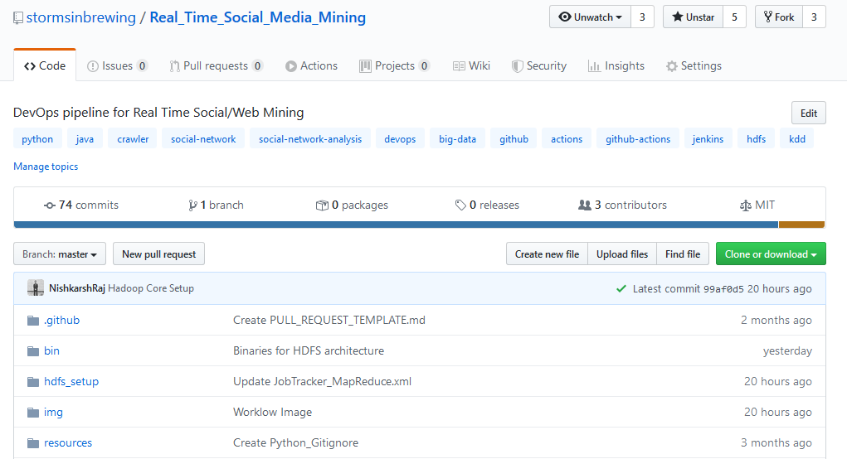
GitHub Repository Setup

Slide 32
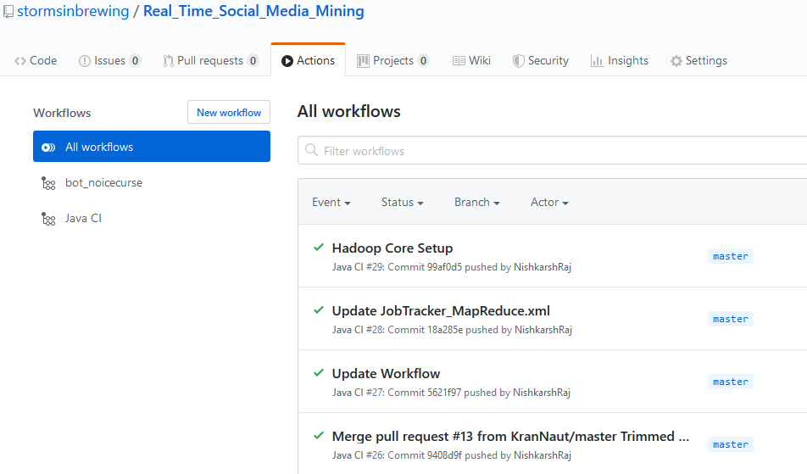
GitHub Actions – Continuous Integration

Slide 33
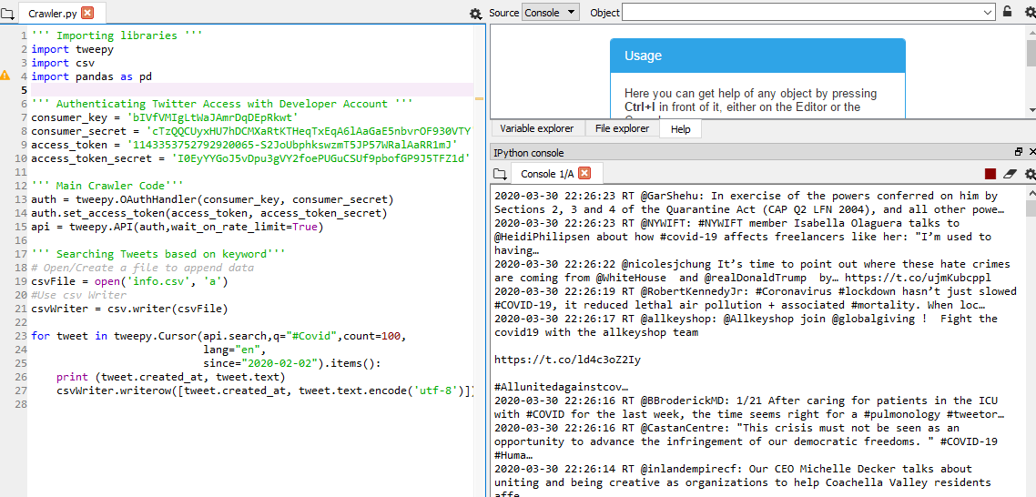
Twitter Crawler

Slide 34
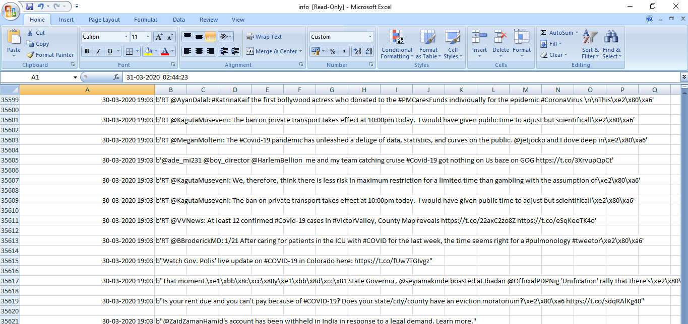
Twitter Crawler CSV output

Slide 35
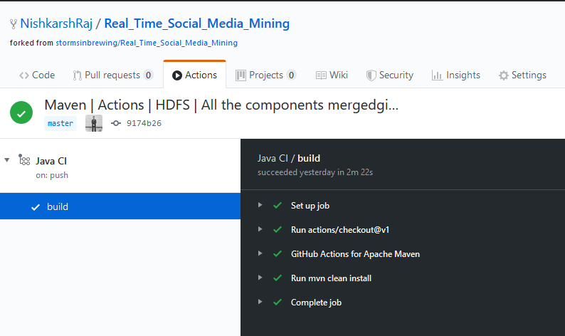
GitHub Actions configuration with Hadoop MapReduce

Slide 36
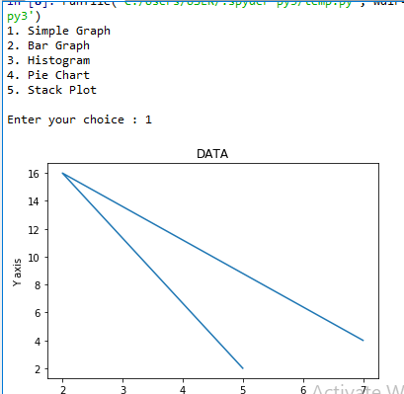
Data Visualization – Simple Graph

Slide 37
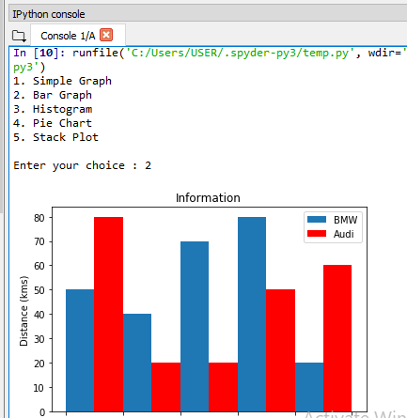
Data Visualization – Bar Graph

Slide 38
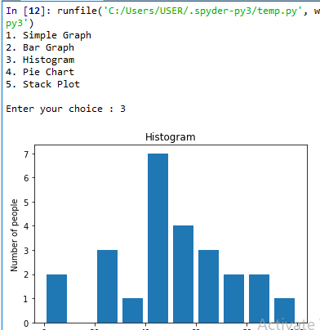
Data Visualization - Histogram

Slide 39
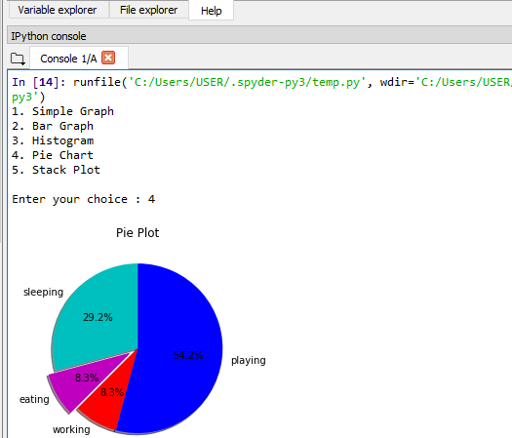
Data Visualization – Pie Chart

Slide 40
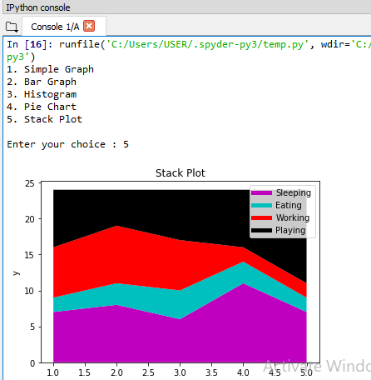
Data Visualization – Stack Plot

Slide 41
References
[1] Lin, Jimmy, and Alek Kolcz. "Large-Scale Machine Learning at Twitter." In Proceedings of the 2012 ACM SIGMOD International Conference on Management of Data, pp. 793-804. ACM, 2012.
[2] Liu, Bingwei, Erik Blasch, Yu Chen, Dan Shen, and Genshe Chen. "Scalable Sentiment Classification for Big Data Analysis Using Naive Bayes Classifier" In Big Data, 2013 IEEE International Conference on, pp. 99-104. IEEE, 2013.
[3] https://www.systemsvalley.com/our-obsession-with-scrum-methodology/
[4] ÁlvaroCuesta, David F., and María D. R-Moreno, "A Framework for Massive Twitter Data Extraction and Analysis", In Malaysian Journal of Computer Science, pp 50-67

